Slide 1
Spring configuration styles
Course “Spring – first touch”
Section 4

Slide 2
Agenda
Xml configuration style
Property files
Annotation configuration style

Slide 3
XML CONFIGURATION STYLE

Slide 4
Simple class
package code;
public class URLParserImpl implement URLParser {
// methods …
}

Slide 5
Class with dependencies
package code;
public class HTMLParserImpl {
private URLParser urlParser;
public HTMLParserImpl(URLParser urlParser) {
this.urlParser = urlParser;
}
// methods …
}

Slide 6
Xml configuration style (1)
<?xml version="1.0" encoding="UTF-8"?>
<beans xmlns="http://www.springframework.org/schema/beans"
xmlns:xsi="http://www.w3.org/2001/XMLSchema-instance"
xsi:schemaLocation="http://www.springframework.org/schema/beans
http://www.springframework.org/schema/beans/spring-beans-3.0.xsd"
default-autowire="constructor">
<bean id=“urlParser"
class="lv.spring.URLParserImpl"/>
<bean id=“htmlParser" class="lv.spring.HTMLParserImpl"/>
</beans>

Slide 7
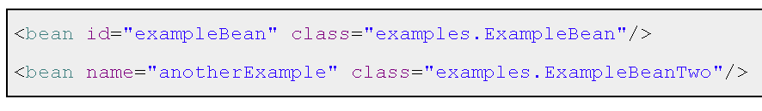
Xml configuration style (2)
Class contains dependencies
Registration of each bean must be presented inside configuration file (xml):

Slide 8
PROPERTY FILES

Slide 9
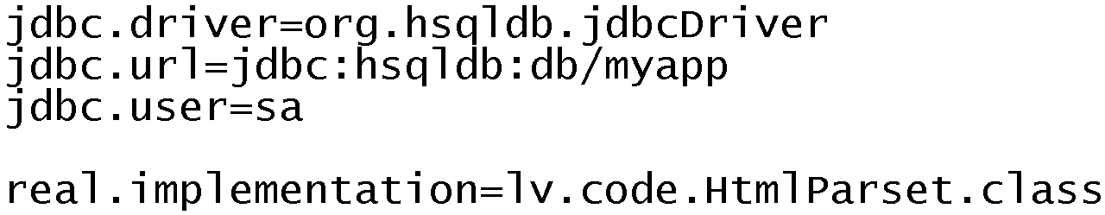
Working with properties
Property file:

Slide 10
Placeholder configuration
<?xml version="1.0" encoding="UTF-8"?>
<beans xmlns="http://www.springframework.org/schema/beans"
xmlns:xsi="http://www.w3.org/2001/XMLSchema-instance"
xmlns:context="http://www.springframework.org/schema/context"
xsi:schemaLocation="http://www.springframework.org/schema/beans
http://www.springframework.org/schema/beans/spring-beans-3.0.xsd
http://www.springframework.org/schema/context
http://www.springframework.org/schema/context/spring-context-3.0.xsd"
default-autowire="constructor">
<context:property-placeholder location="classpath:env.properties"/>
<bean id="database" class="${database.class}"/>
</beans>

Slide 11
Placeholder usage example
<?xml version="1.0" encoding="UTF-8"?>
<beans …>
<context:property-placeholder location="classpath:env.properties"/>
<bean id="database" class="${database.class}"/>
<bean id="dataSource“ class="org.apache.commons.dbcp.BasicDataSource“
destroy-method="close">
<property name="driverClassName"
value="${jdbc.driver_class}"/>
<property name="url"
value="${jdbc.url}" />
<property name="username"
value="${jdbc.username}" />
<property name="password"
value="${jdbc.password}" />
</bean>
</beans>

Slide 12
ANNOTATION CONFIGURATION STYLE

Slide 13
Class annotations
@Component
  @Service
  @Repository
  @Controller
Annotate bean with @Component
= deploy bean to Spring IoC Container!

Slide 14
@Component (1)
package code;
import org.springframework.stereotype.Component;
@Component
public class URLParserImpl implement URLParser {
// methods …
}

Slide 15
@Component (2)
package code;
import org.springframework.stereotype.Component;
@Component
public class HTMLParserImpl {
private URLParser urlParser;
public HTMLParserImpl(URLParser urlParser) {
this.urlParser = urlParser;
}
// methods …
}

Slide 16
Classpath scanning
<?xml version="1.0" encoding="UTF-8"?>
<beans xmlns="http://www.springframework.org/schema/beans"
xmlns:xsi="http://www.w3.org/2001/XMLSchema-instance"
xmlns:context="http://www.springframework.org/schema/context"
xsi:schemaLocation="http://www.springframework.org/schema/beans
http://www.springframework.org/schema/beans/spring-beans-3.0.xsd
http://www.springframework.org/schema/context
http://www.springframework.org/schema/context/spring-context-3.0.xsd">
<context:component-scan
base-package="lv.spring"/>
</beans>

Slide 17
Default-autowired
<?xml version="1.0" encoding="UTF-8"?>
<beans xmlns="http://www.springframework.org/schema/beans"
xmlns:xsi="http://www.w3.org/2001/XMLSchema-instance"
xmlns:context="http://www.springframework.org/schema/context"
xsi:schemaLocation="http://www.springframework.org/schema/beans
http://www.springframework.org/schema/beans/spring-beans-3.0.xsd
http://www.springframework.org/schema/context
http://www.springframework.org/schema/context/spring-context-3.0.xsd"
default-autowire="constructor">
</beans>

Slide 18
DI with @Autowired
package code;
import org.springframework.stereotype.Component;
import org.springframework.beans.factory.annotation.Autowired;
@Component
public class HTMLParserImpl {
@Autowired
private URLParser urlParser;
// methods …
}

Slide 19
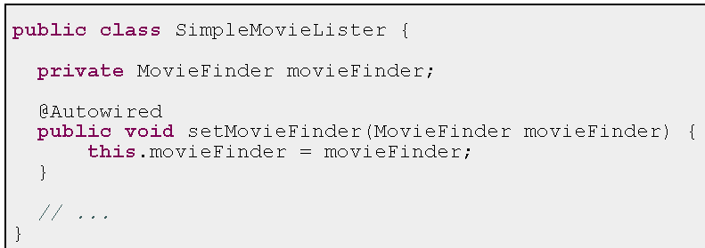
@Autowired – setter methods

Slide 20
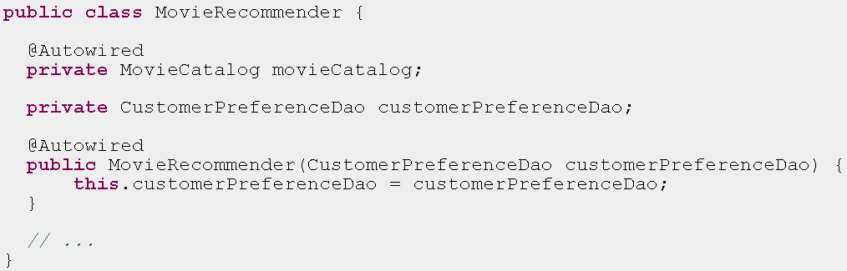
@Autowired cons and fields

Slide 21
If possible use annotations ☺
@Component
@Autowired

Slide 22

Any Questions?

Slide 23

References
Spring in Action 2 edition
Spring documentation: http://www.springsource.org/documentation

Slide 24

Practice 4

